Slide 1
DIRECT TORQUE CONTROL OF DFIG USING ANN SEMINAR PRESENTATION SARDAR PATEL COLLEGE OF ENGINEERING
BY,
NINAD KIRAN GAIKWAD
ME ELECTRICAL
ROLL NO - 06

Slide 2
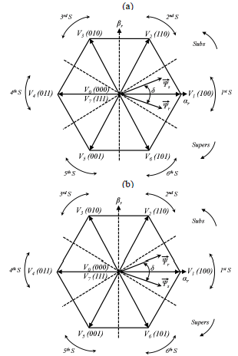

PRINCIPLE OF DTC

Slide 3
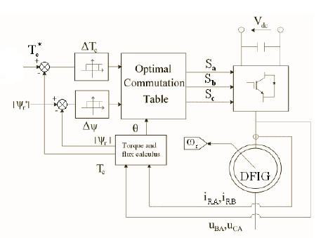
DTC CONTROL STRATEGY IN DFIG

Slide 4
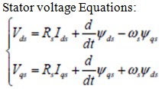
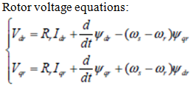




DFIG MODEL IN d-q FRAME

Slide 5
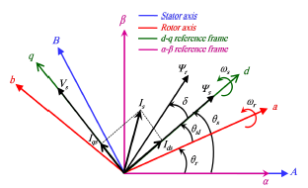
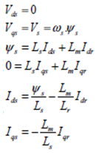
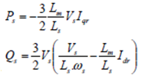
DFIG MODEL IN STATOR FLUX ORIENTED d-q FRAME

Slide 6
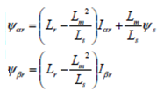



TORQUE AND ROTOR FLUX ESTIMATION
TORQUE ESTIMATION
ROTOR FLUX ESTIMATION

Slide 7
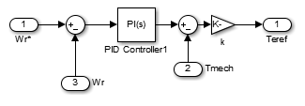
TORQUE REFERENCE GENERATION

Slide 8
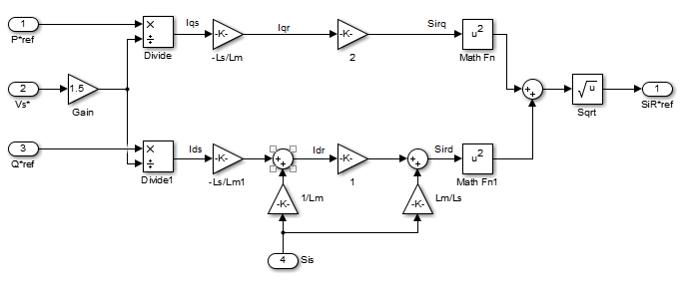
ROTOR FLUX REFERENCE GENERATION

Slide 9

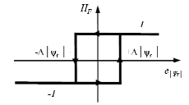
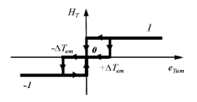
HYSTERESIS CONTROLLERS
TWO LEVEL HYSTERESIS CONTROLLER
THREE LEVEL HYSTERESIS CONTROLLER

Slide 10

ROTOR FLUX SECTOR POSITION ESTIMATION

Slide 11
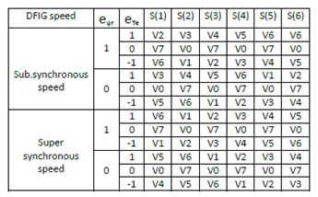
LOOK-UP TABLE FOR ROTOR VOLTAGE VECTORS

Slide 12
PROBLEMS WITH CONVENTIONAL-DTC
Due to fixed sampling frequency and limited minimum hysteresis bands, undesired ripples are present in torque and flux
Selected voltage vector is not necessarily the most suitable one.
Variable switching frequency operation
High switching frequency results in high harmonic distortion of currents and heating of semiconductor switches.

Slide 13
SOLUTION TO THE ABOVE PROBLEM
Using an artificial neural network for determining the rotor voltage vectors
It reduces the switching frequency making is almost constant
Hence reduces undesirable ripples in torque and flux
Also, reduces harmonic distortion of the currents

Slide 14
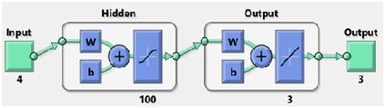
ANN

Slide 15
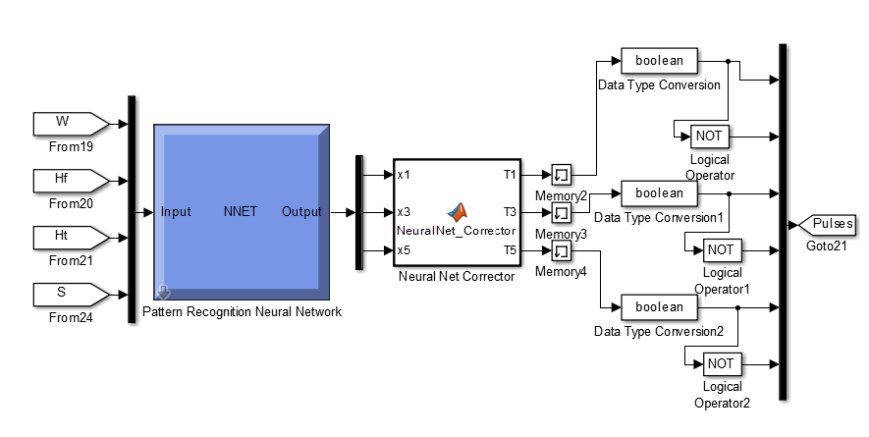
ANN WITH CORRECTOR

Slide 16
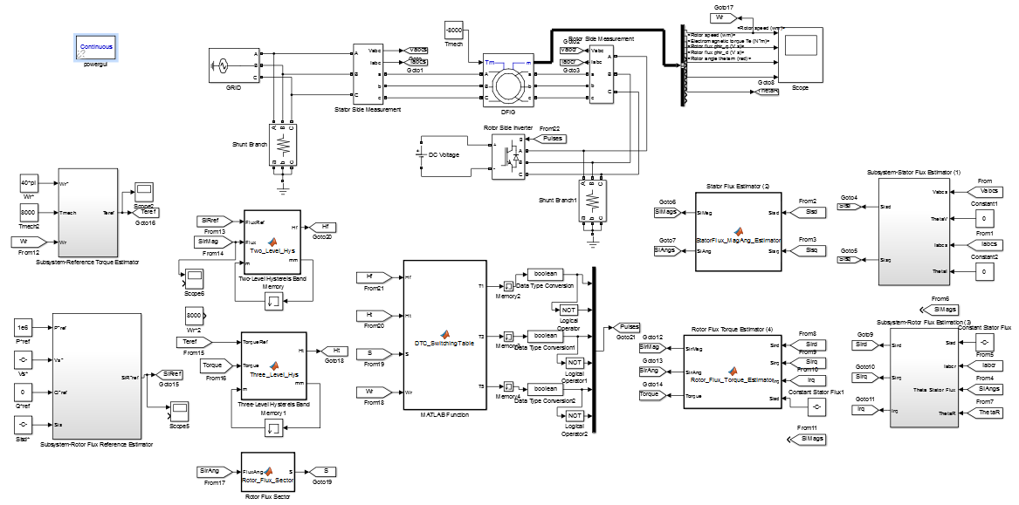
SIMULINK MODEL OF C-DTC

Slide 17
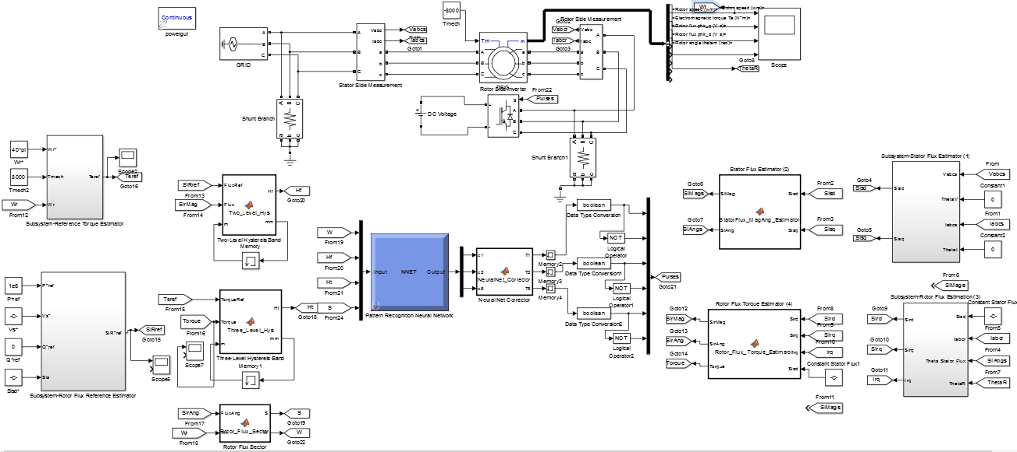
SIMULINK MODEL OF ANN-DTC

Slide 18
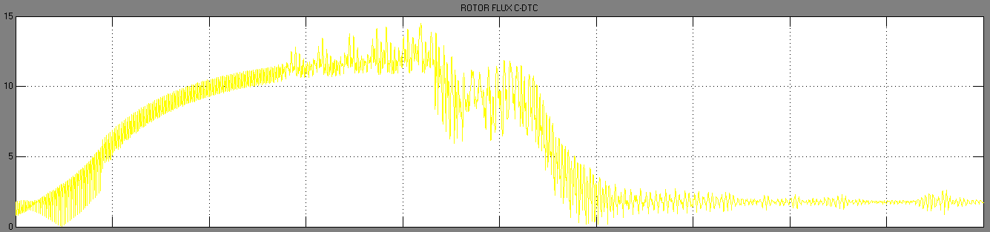
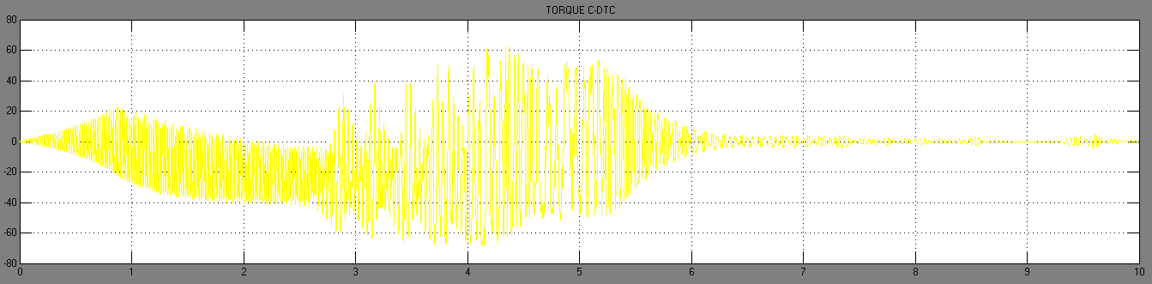
SIMULATION RESULTS FOR C-DTC

Slide 19
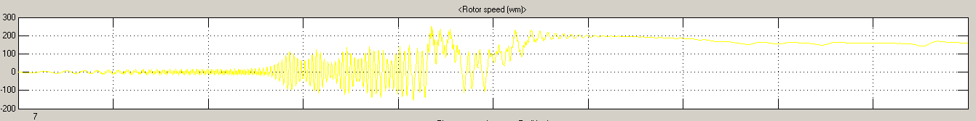
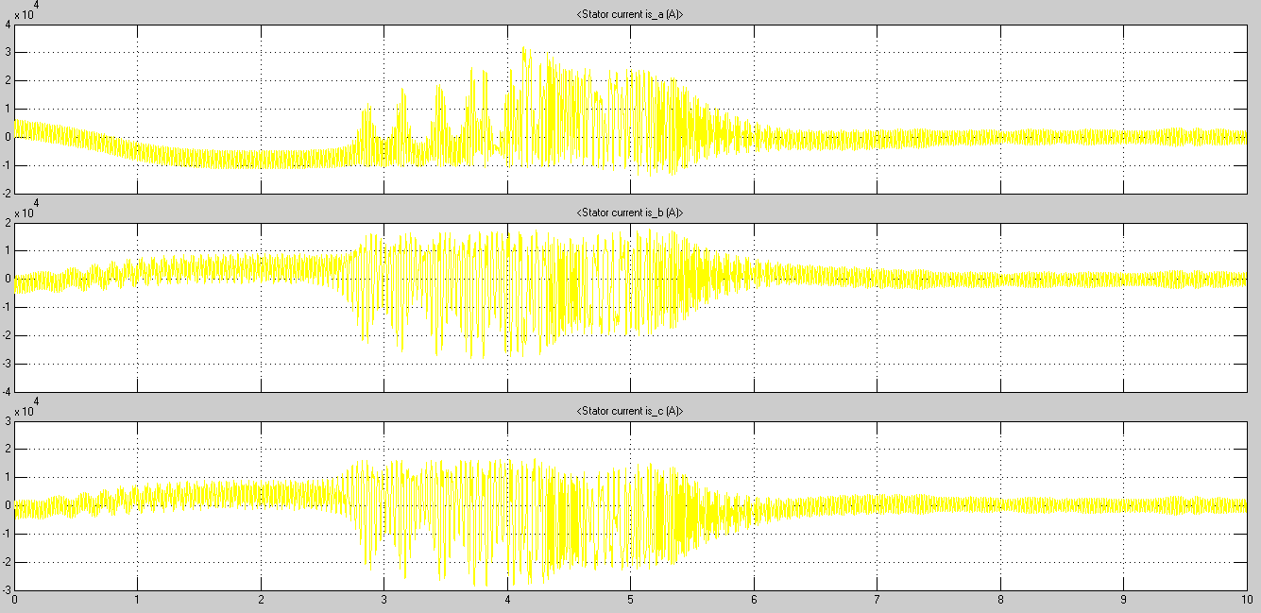

Slide 20
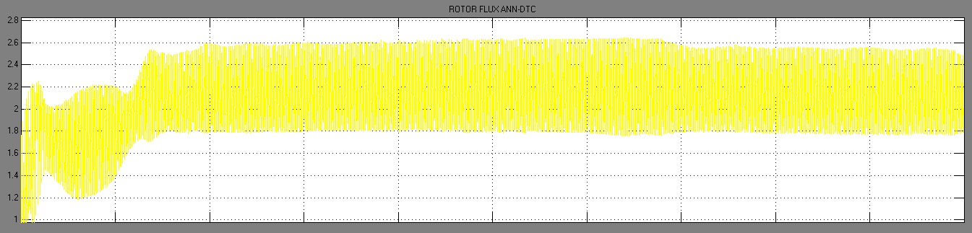
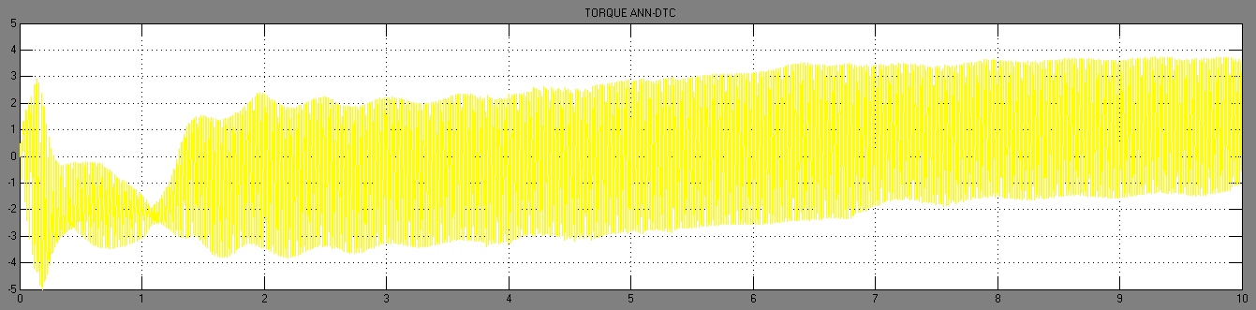
SIMULATION RESULTS FOR ANN-DTC

Slide 21
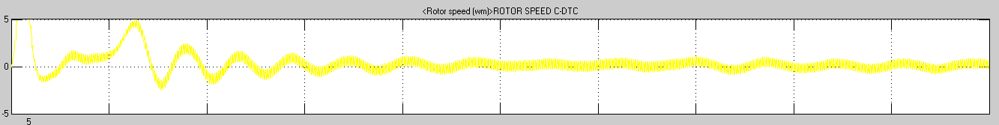
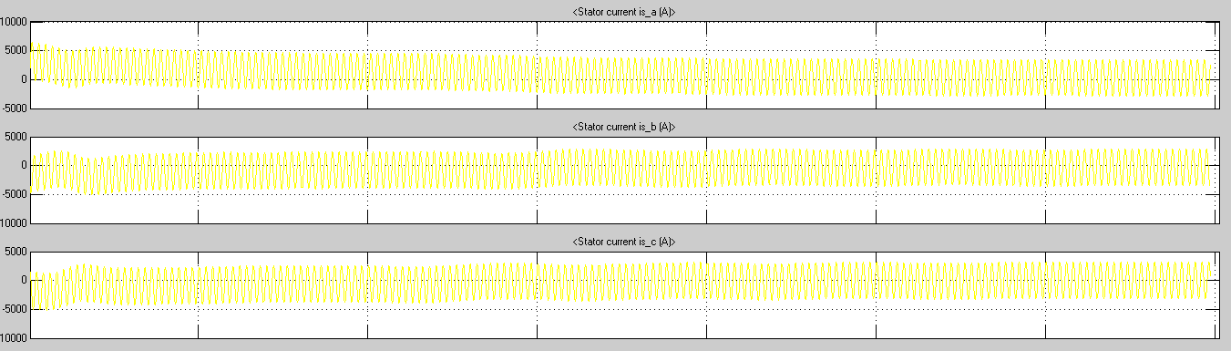

Slide 22
CONCLUSIONS
DTC strategy provides with fast dynamic response without the inner current control loops of FOC
It is simpler to implement than FOC
C-DTC has a problem of variable switching frequency operation which results in undesirable effects of ripples and harmonics
ANN-DTC has an almost constant switching frequency which mitigates the problems present in C-DTC

Slide 23
THANK YOU

